Slide 1
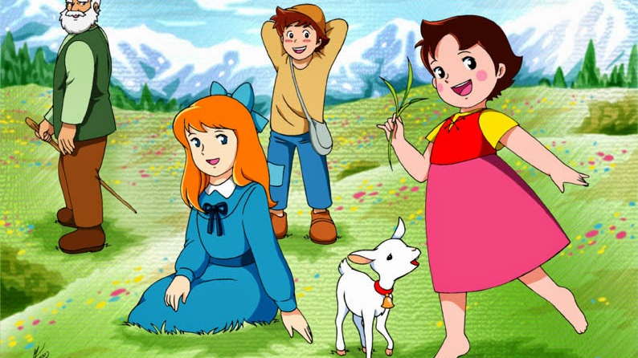
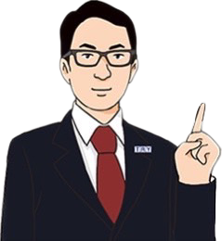
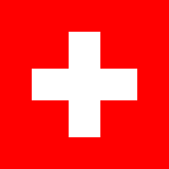
NATSUKI
MAMI
Alexis
Switzerland

Slide 2
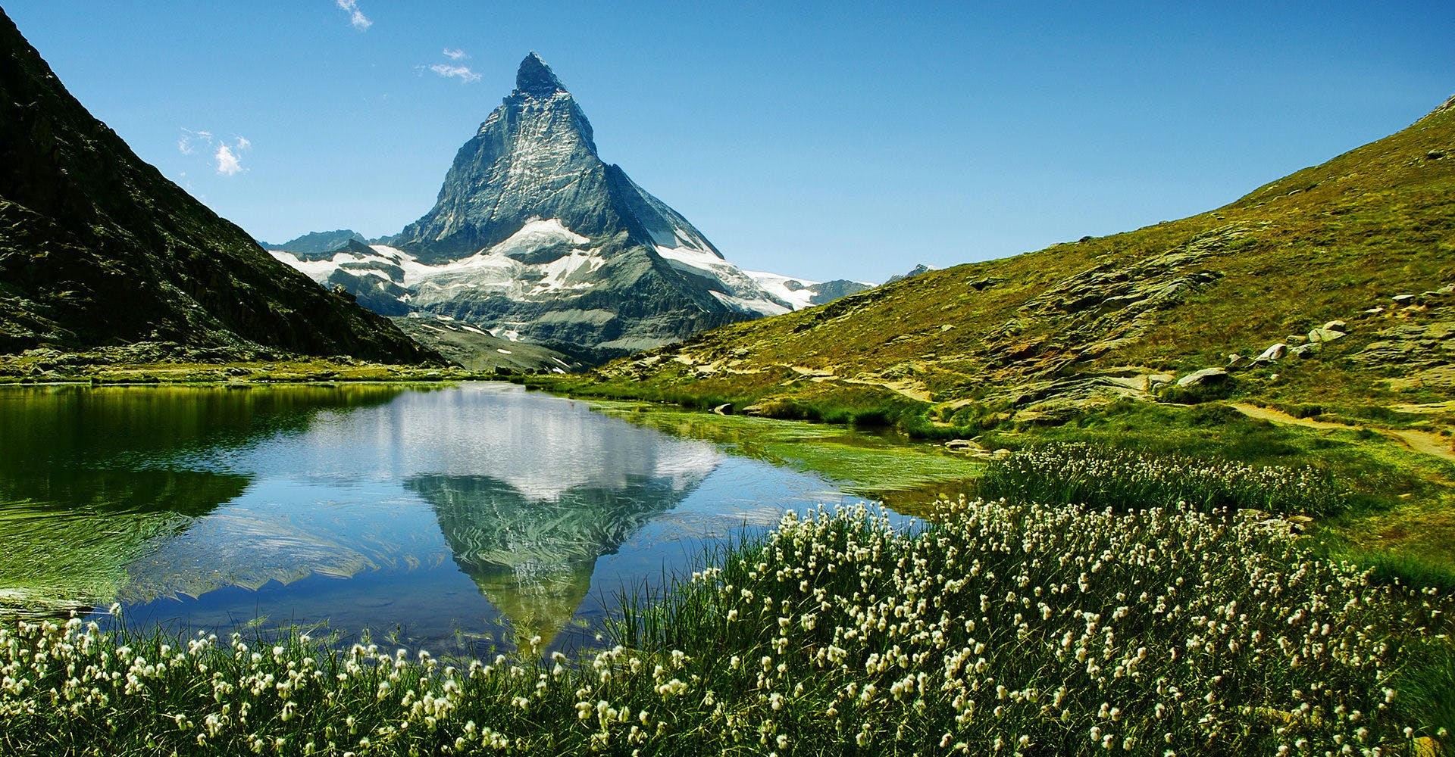
4,478m
Matterhorn

Slide 3
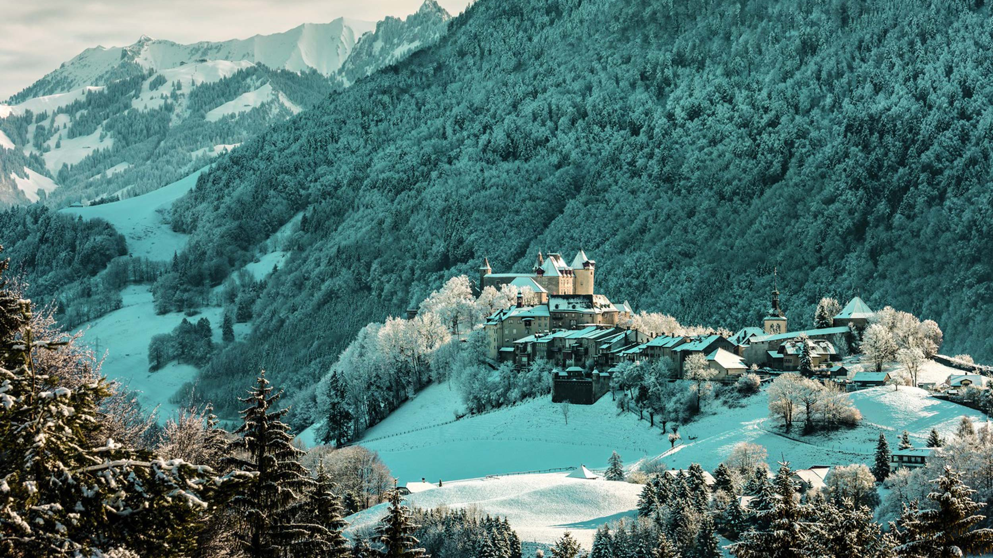
Snow

Slide 4
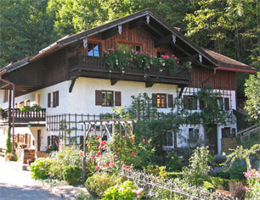
Architecture
Chalet

Slide 5
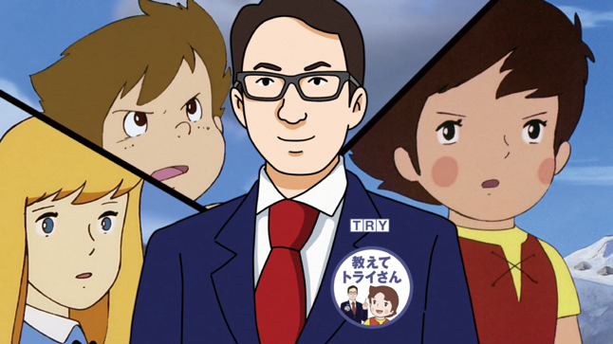
Mr. TRY

Slide 6
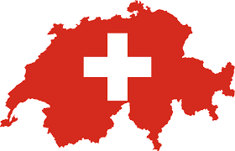
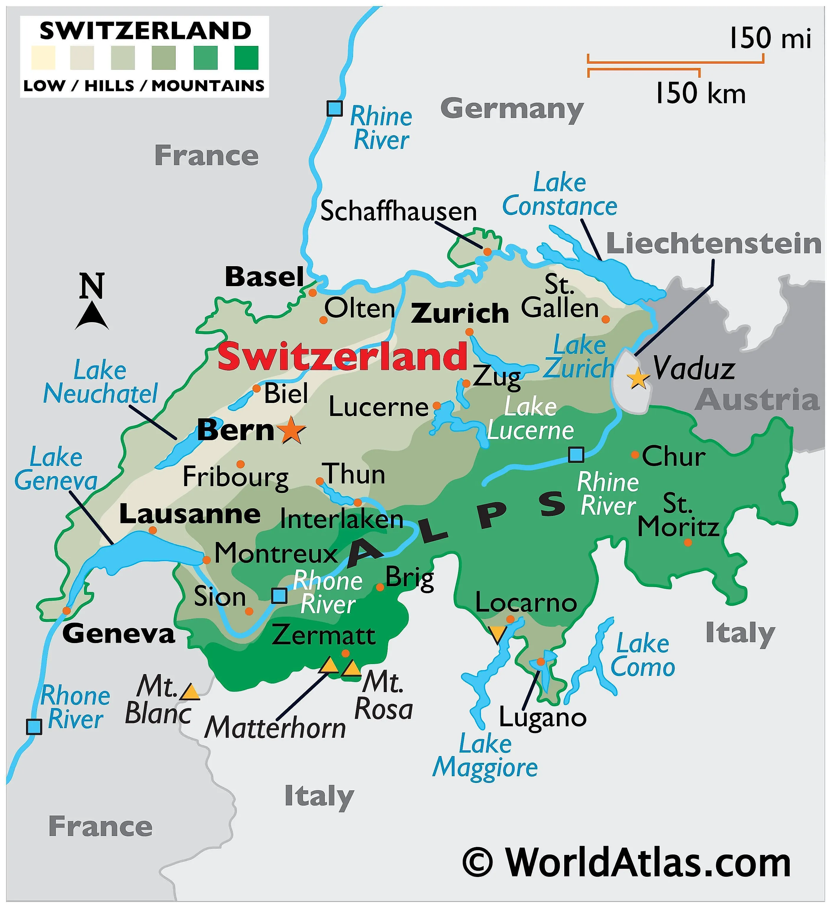
Introduction
-Country name: Switzerland
-Capital: Bern
-Population: 8,771,000 (2022)
-language: German, French, Italian, Romansh
-Famous: Heide, Matterhorn, Bern

Slide 7
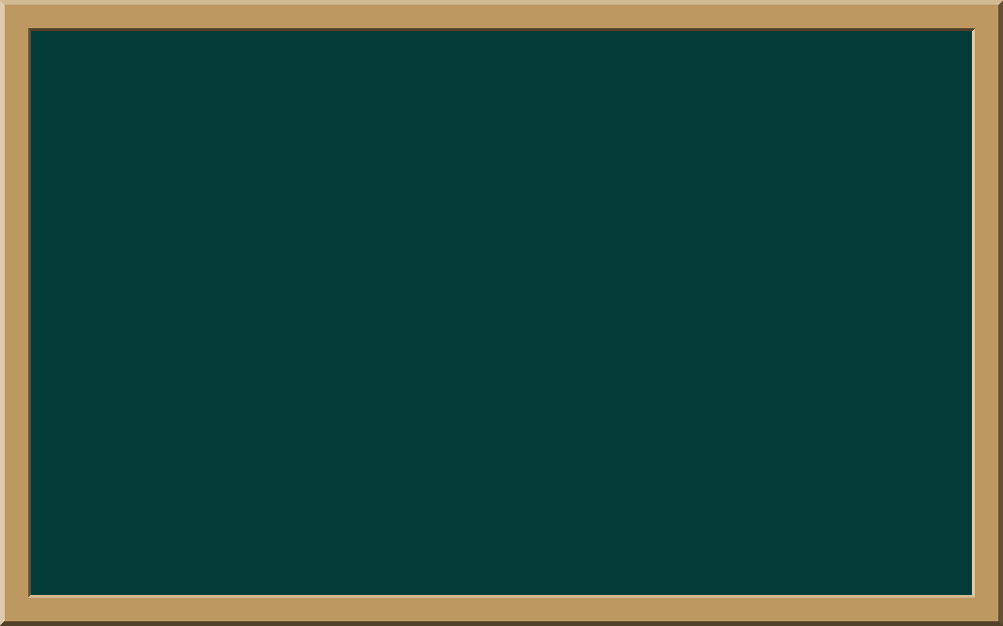
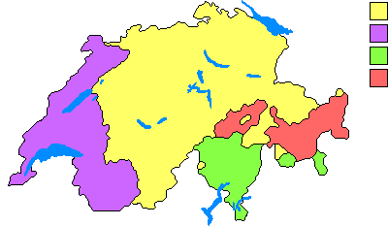
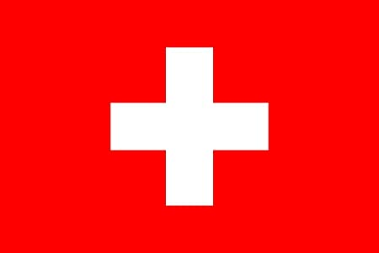
German(62.8%)
French(22.9%)
Italian(8.2%)
Romansh(0.5%)
Language

Slide 8
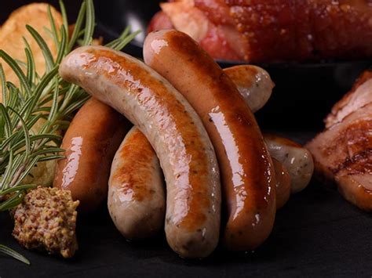
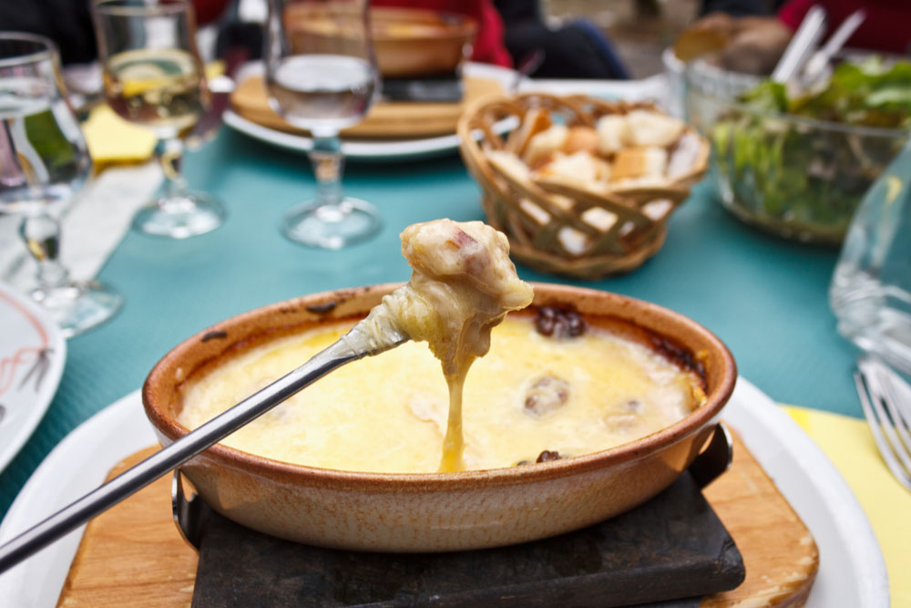
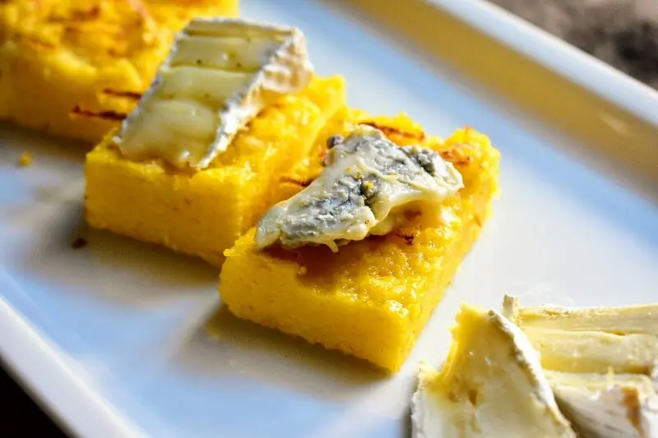
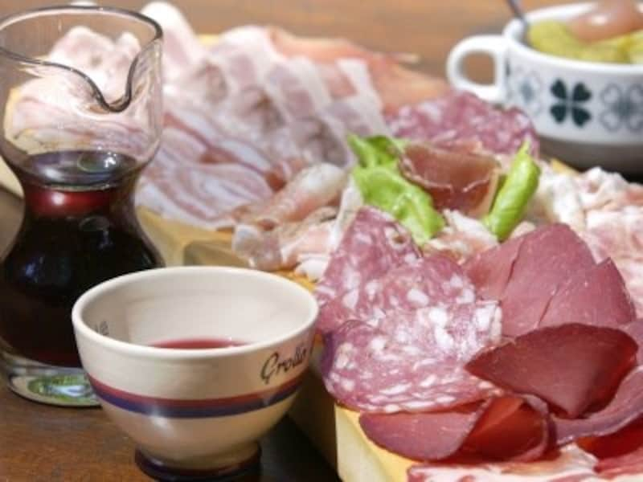
German area
French area
Italian area
Romansh area
Bratwurst
Fondue
Polenta
Bündnerfleisch

Slide 9
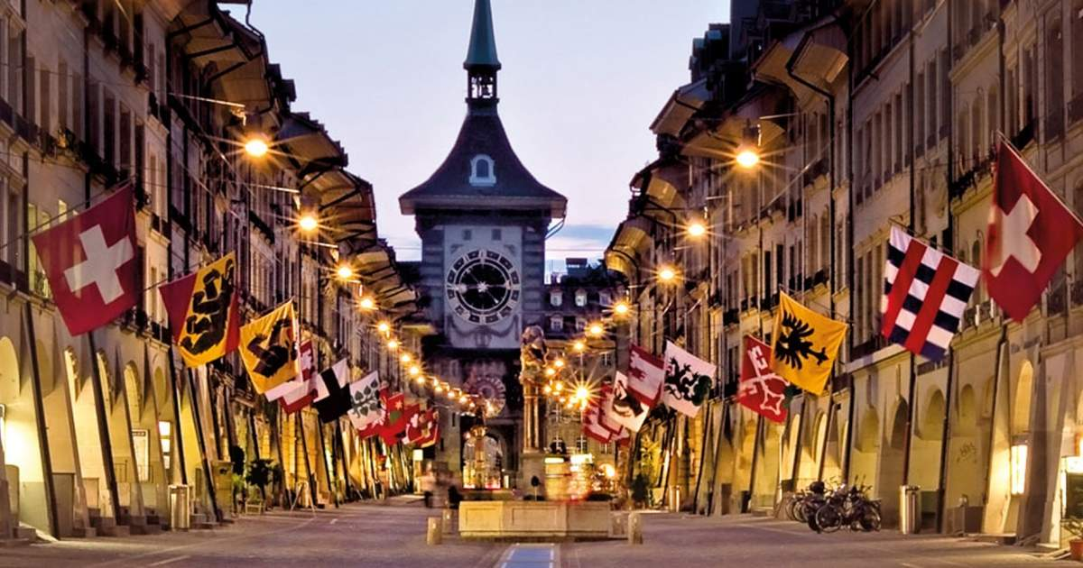
The Culture Of Switzerland
・The culture of Switzerland is heavily influenced by the cultures of neighboring nations
Very acceptable to new things

Slide 10
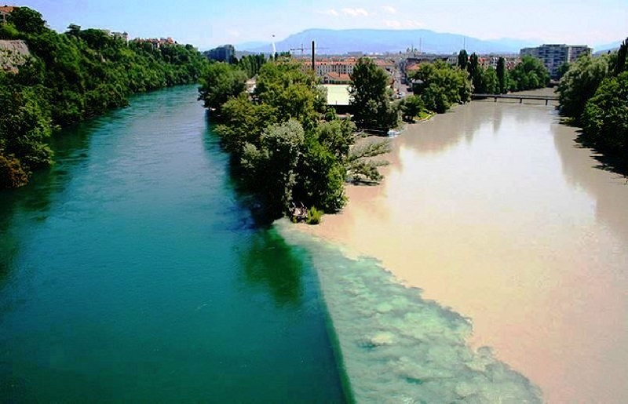
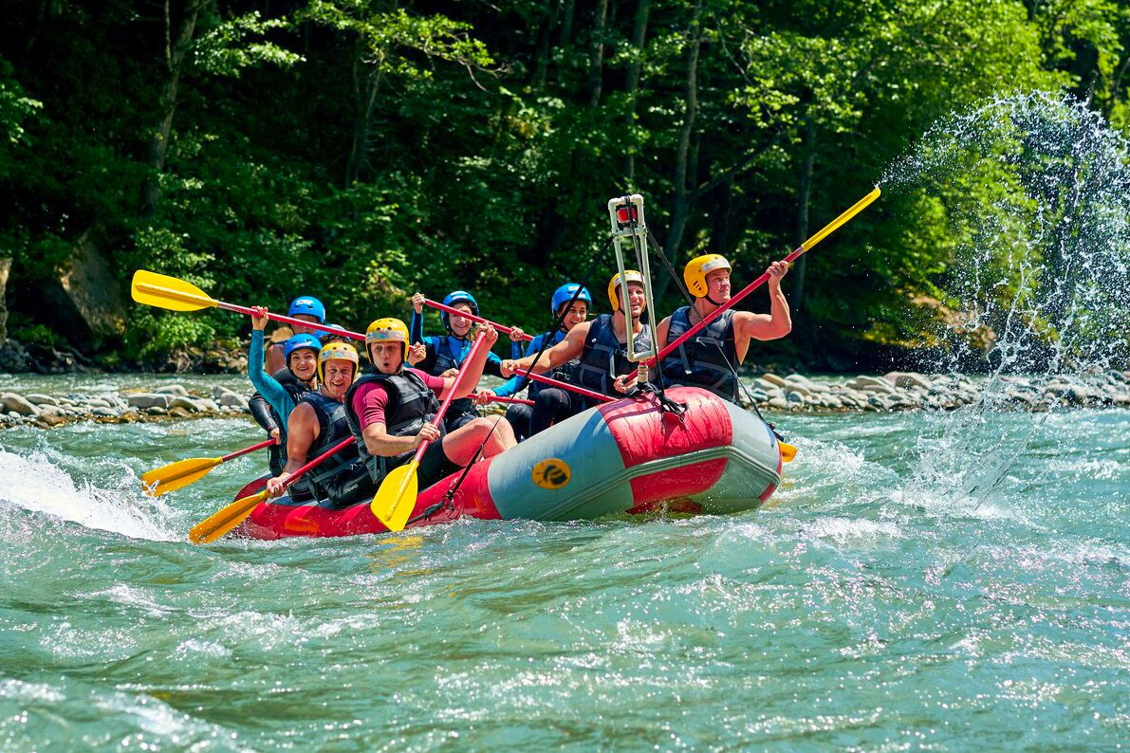
Sightseeing spot
Rhone river and Arve river
→ different water quality and temperature
Water sports
→ Rafting
Geneva river

Slide 11
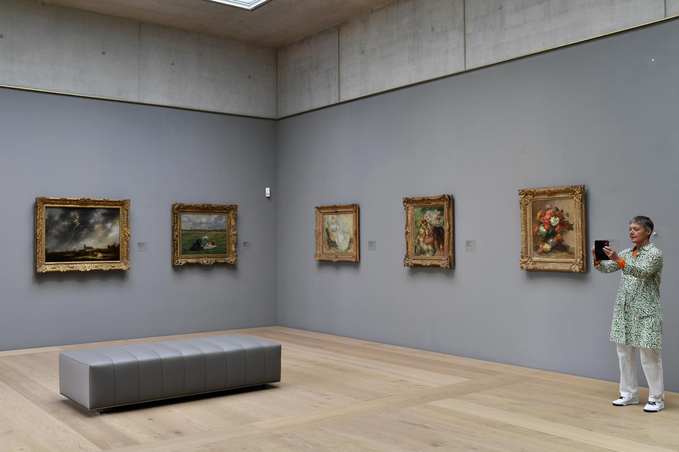
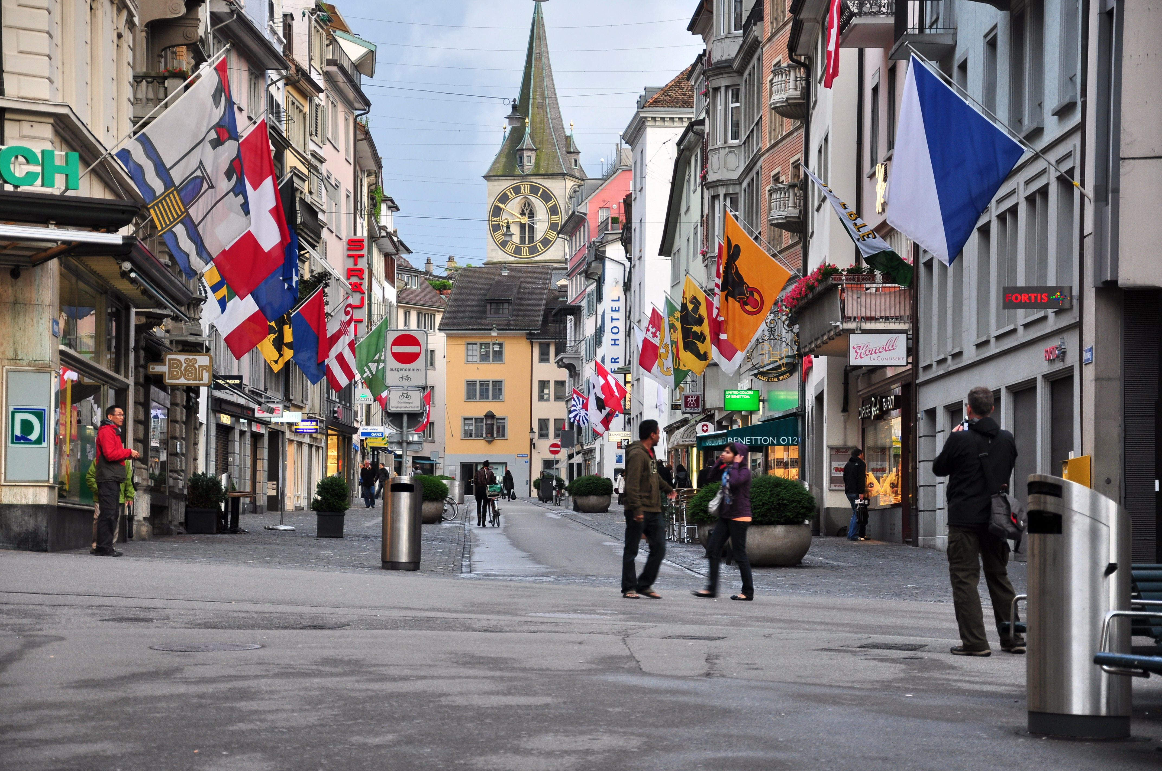
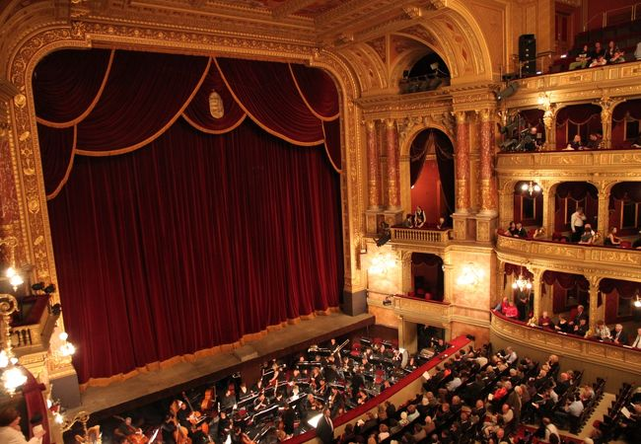
Zurich
Largest city
Cafe, shop, and galleries
Bahnhofstrasse
Zurich opera house
Zurich art museum

Slide 12
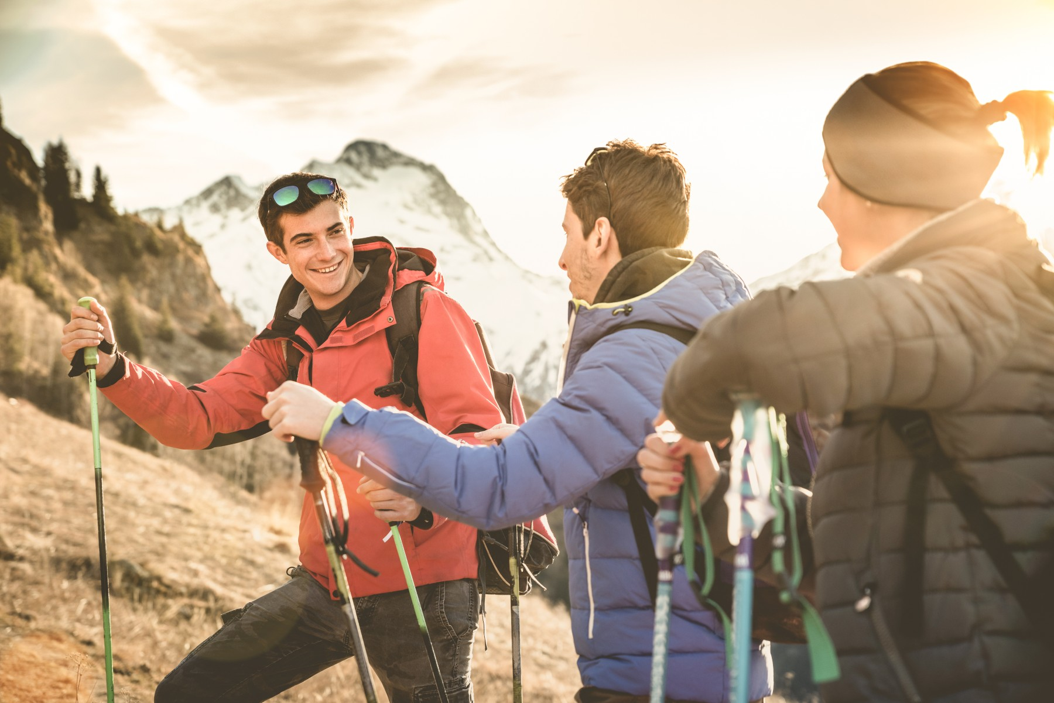
power distance
LOW
Handshake
Maintain eye contact
Air kiss on the cheek

Slide 13
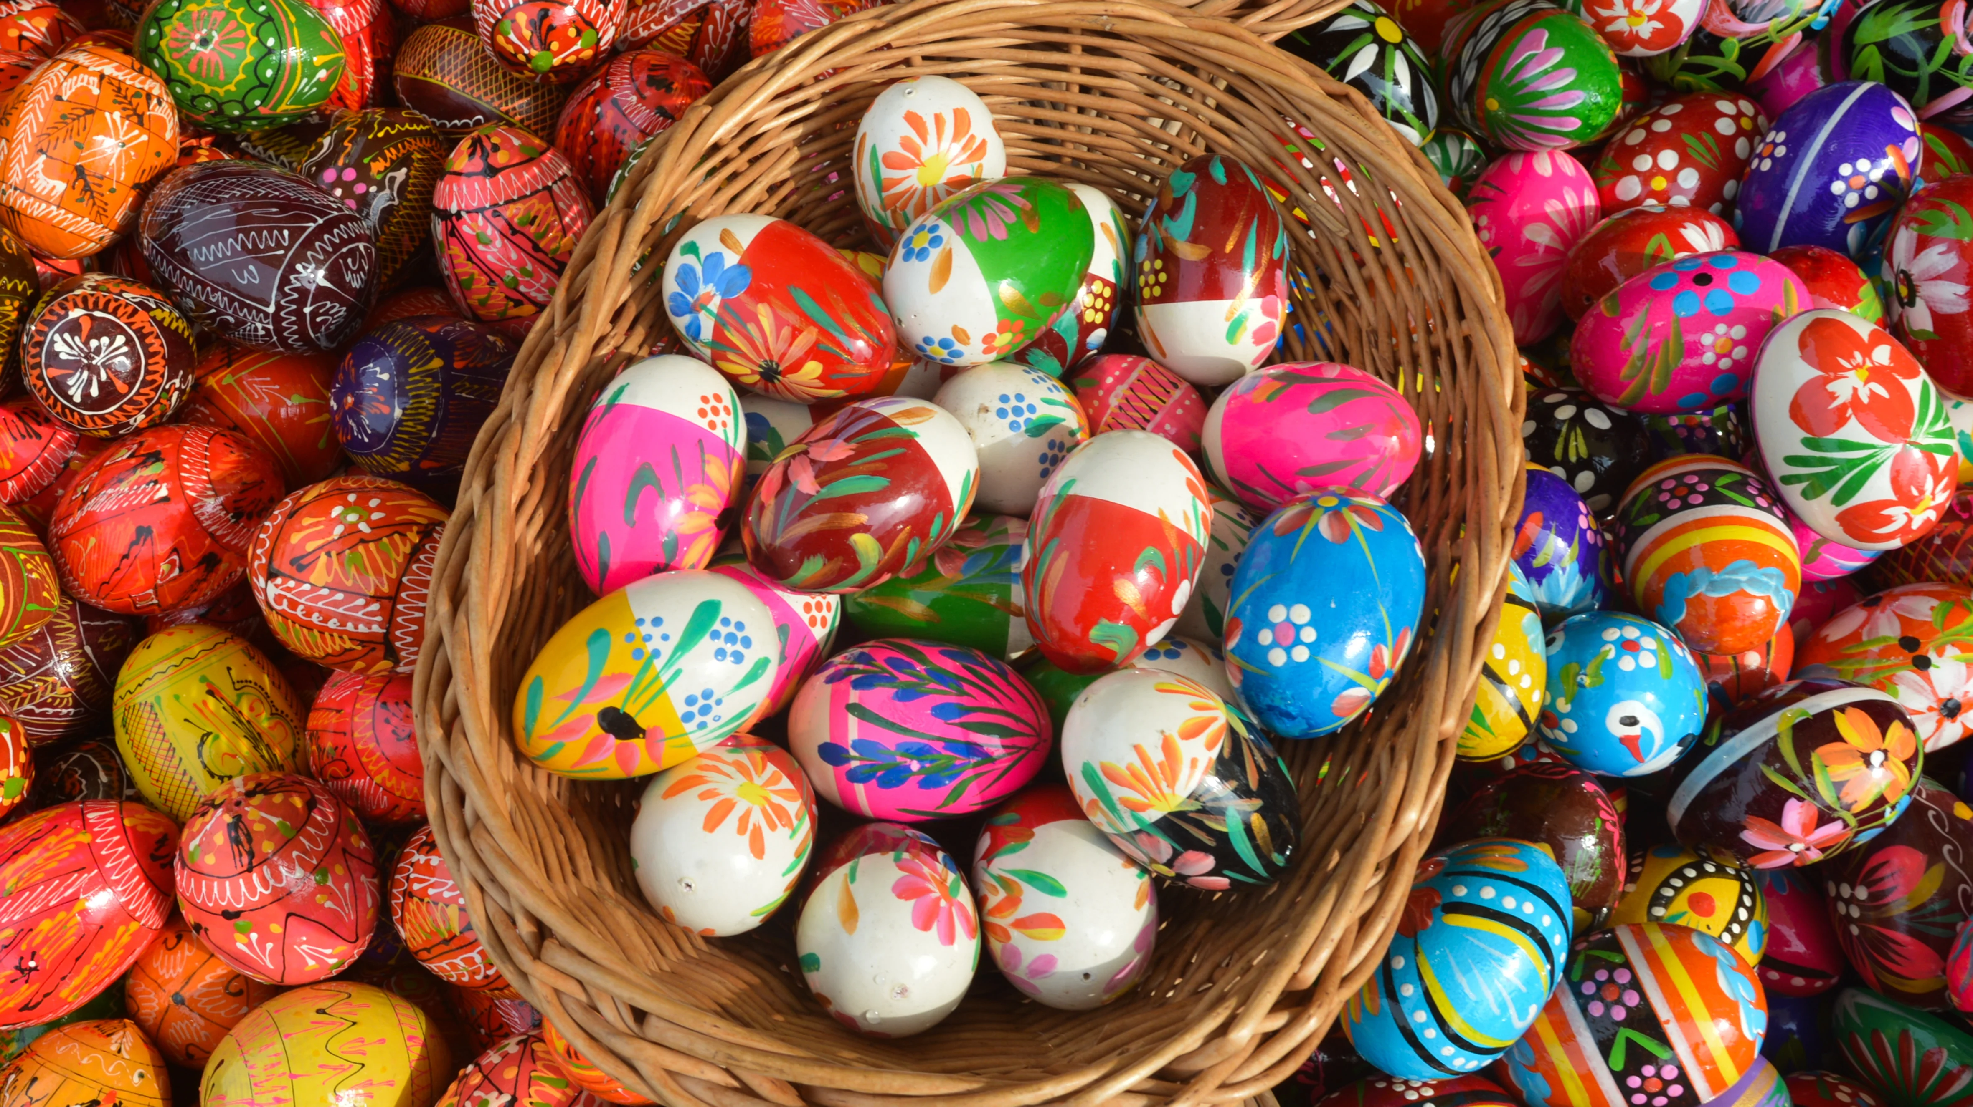
Easter

Slide 14
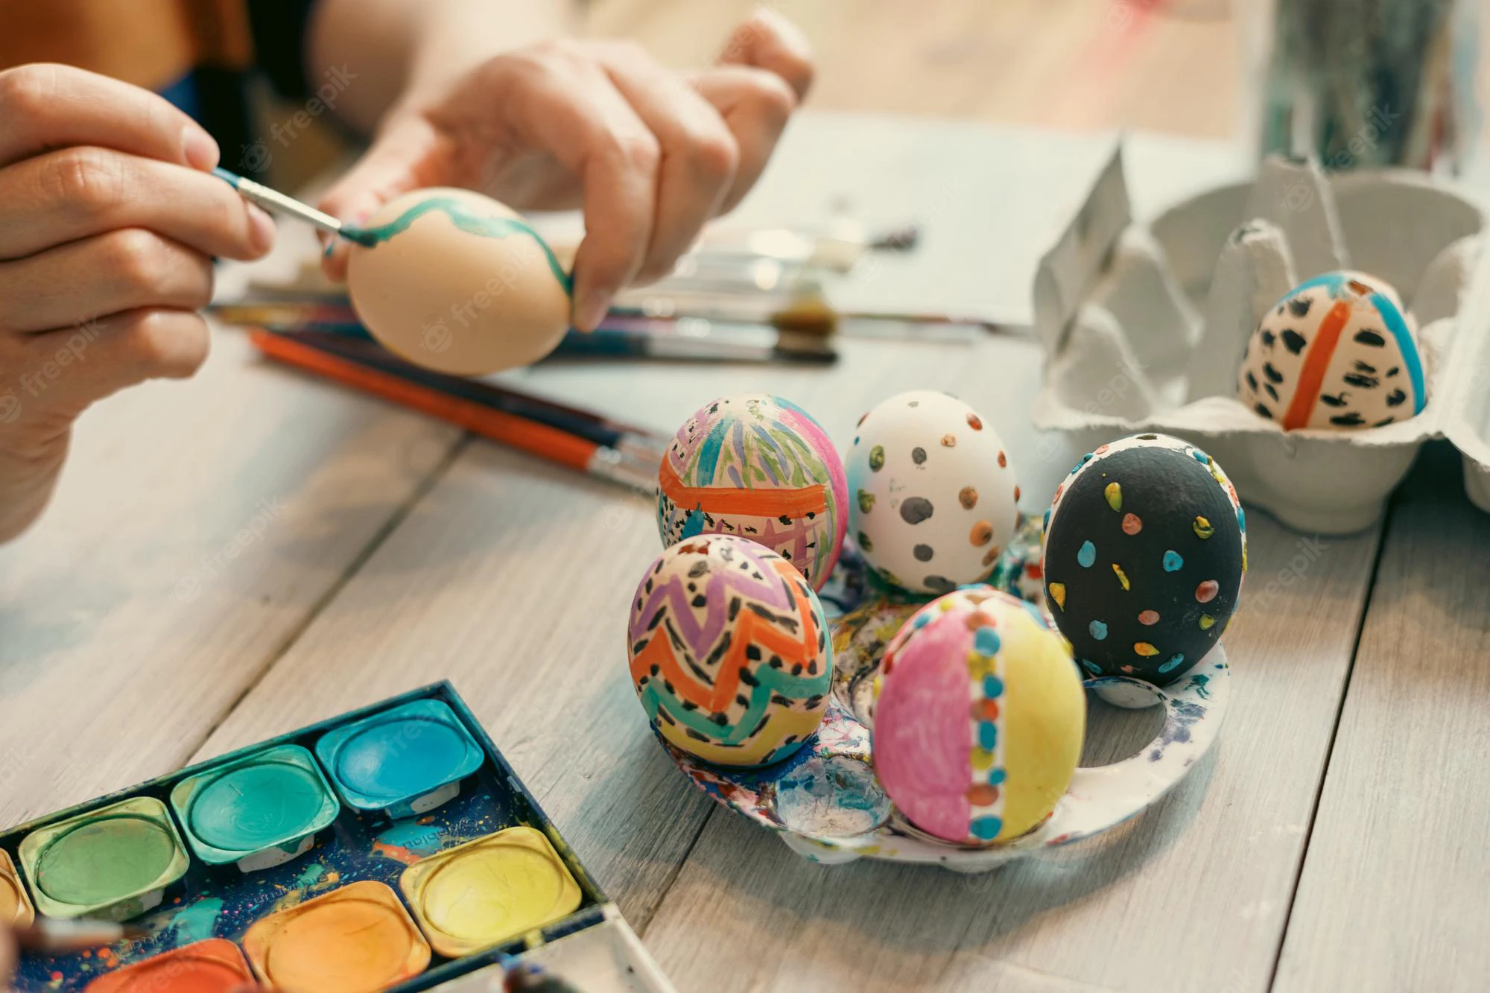
Egg Painting

Slide 15
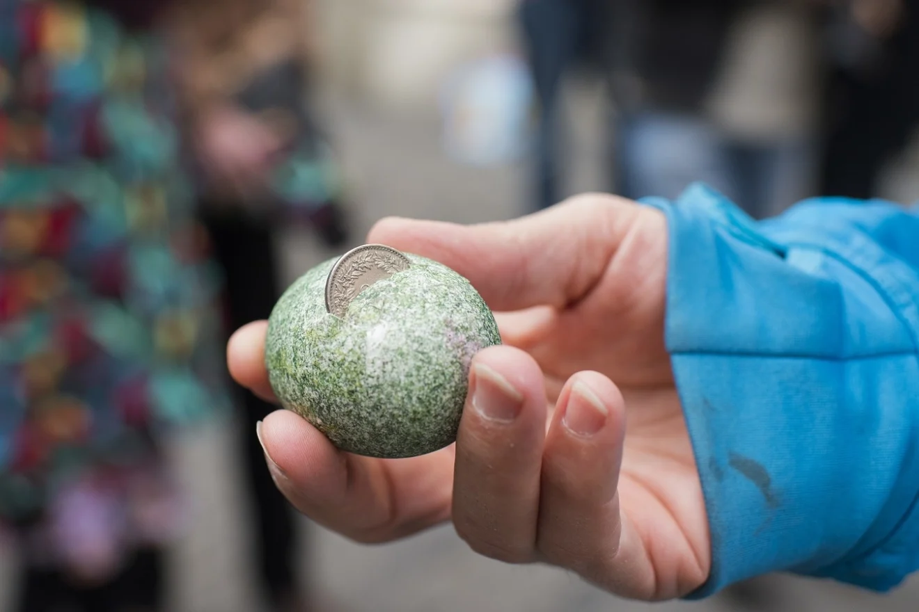
Zwänzgerle
Started around the 18th century
Hit the egg for 20 cents
If it sticks in the egg, it is a success!!

Slide 16
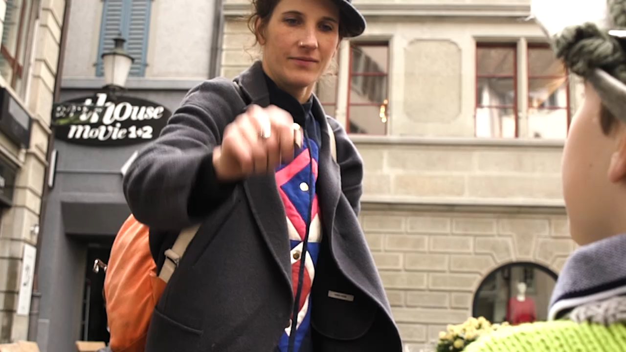

Slide 17
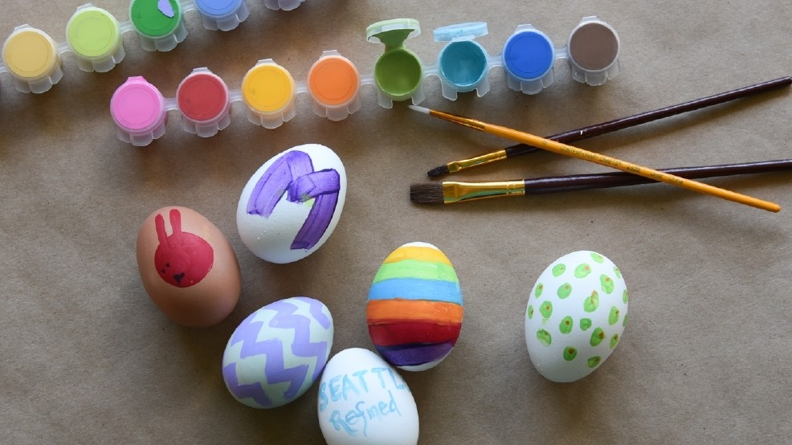
Let’s try!!

Slide 18
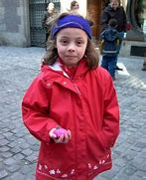
Beat me, if you can.

Slide 19
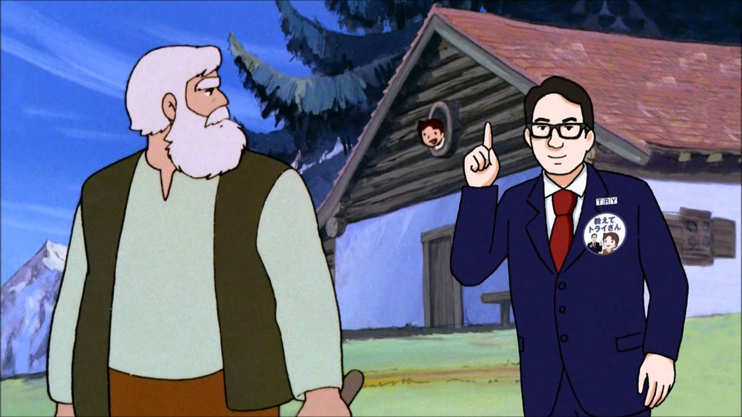
Thank you for listening

